Slide 1
CSI PACIFIC PERFORMANCE PROJECTS 2022 Staff Advance April 12 & 13, 2022 Victoria

Slide 2
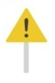
Multi Step Project “PITCH”
Step 1. The Problem
What problem (gap) are you actually trying to create a solution for?
Can you provide evidence that the problem exists?
Does the problem relate to the performance or health determinants of sport? Or could a solution to a problem result in positive impact for the institute, without negatively impacting our purpose? (if not, should we be trying to solve this problem?)
Try and distill the problem down to its simplest form. Ideally you should be able to describe the problem you are solving in one or two sentences or bullet points.

Slide 3
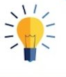
Multi Step Project “PITCH”
Step 2. Your Solution(s)
A clear problem statement will help you focus your solution on solving just one main focus problem.
Again you should be able to describe your solution(s) at a high level in just a few sentences or bullet points.

Slide 4
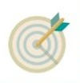
Multi Step Project “PITCH”
Step 3. Target Market
Describe the market segments/type of client/customer you are targeting. Who does this problem focus on? What makes them unique? (e.g. is this just for elite athletes? Able or para or both? Next Gen? Community? Winter vs. Summer sports or both? NSO vs. PSO?)
Can you get any sense of projected number of client/customers that might be interested in this solution?
Are there any other aspects of the target market (or target customers/client) that are relevant to this problem and solution?

Slide 5
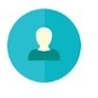
Multi Step Project “PITCH”
Step 4. Competition Benchmarking
Who are your actual competitors? (name them, in some instances there might not be direct competition). Are they located locally, or within BC or within Canada or Internationally?
Describe your key differentiators that make your solution different than your competition.
[KPI: Is your solution unique enough that your target market (customers) will choose your solution over alternatives?]

Slide 6
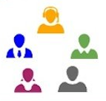
Multi Step Project “PITCH”
Step 5. Highlight Your Team Advantage
Highlight how you and your time are the right team to execute on your vision!
Aspects of the CSI Pacific Institute Advantage should play front and center here. No matter how great or unique your solution is, if you don’t have the right people, places and programs, you won’t be able to see it to fruition.

Slide 7
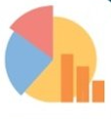
Multi Step Project “PITCH”
Step 6. Business Model
Ideally you can pull together a draft top-level forecast of potential revenues and expenses into a draft budget (a detailed forecast not needed now). What are the estimated projects costs to implement your solution? Is there enough revenues to cover costs in a sustainable manner?
The most important part is that you can show/articulate the business model, or within the context of sport, show that in a non-for profit model, there would be enough interest to support the solutions.

Slide 8
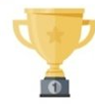
Multi Step Project “PITCH”
Step 7. Milestones
Highlight your upcoming goals and when you plan to achieve them. Consider developing a draft Gantt Chart for key milestones.

Slide 9
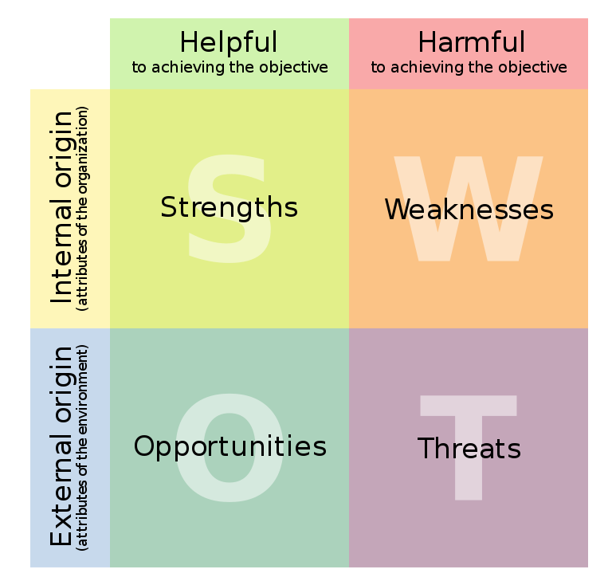
Multi Step Project “PITCH”
Step 8. SWOT (optional)
If you have been able to collect enough information in steps 1 through 7, consider developing a single slide SWOT analysis.

